Slide 1

BASIS DATA - TI14KB21
Meeting 4
Enhanced Entity Relational Model and Diagram
Bagus Kristomoyo Kristanto S.Kom , M.MT
bagus.kristanto@stiki.ac.id

Slide 2
Outline
01
Discussion About Quiz
Discussion about quiz
02
Enhanced Entity Relational Diagram
Drawing notation on Entity Relational Model

Slide 3
Hierarchical Organisation Structure
Create Entity Relational Model based assumption below :
A group (Group-ID) has several companies (Comp-ID), whereas a company belongs to one group.
Companies are connected by a hierarchical structure; each subsidiary is assigned to exactly one company of the next higher hierarchy level, the parent company.
Each company has several plants (Plant-ID); a plant belongs to one company only
A plant produces many items (Item-#). An item is only produced in one of the plants.

Slide 4
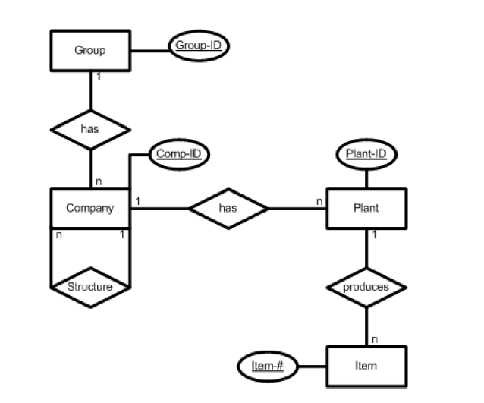
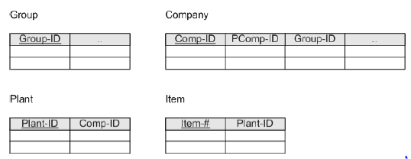
Hierarchical Organisation Structure

Slide 5
Simple Flight Database
Create Entity Relational Model based assumption below :
An airplane (Tail-#) is assigned to several flights (Flight-#). A flight is assigned to only one airplane.
A pilot (SocialSec-ID) can perform several flights. A flight is performed by several (normally at least two) pilots.

Slide 6
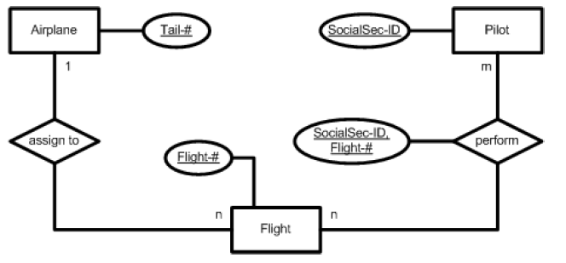
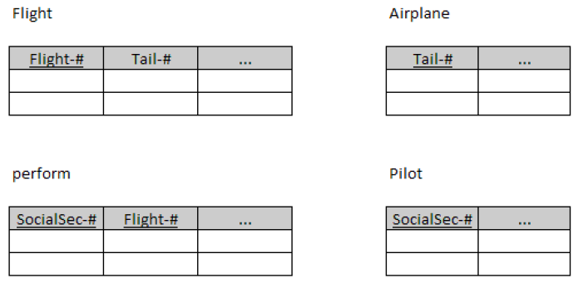
Simple Flight Database

Slide 7
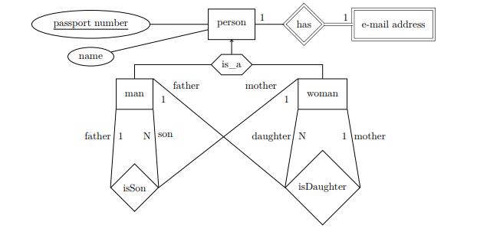
Person Database
Create Assumption based on below ERM

Slide 8
Enhanced Entity Relational Diagram
Specialization/generalization , Aggregation , Composition

Slide 9
Enhanced Entity-Relationship Model
Since 1980s there has been an increase in emergence of new database applications with more demanding requirements.
Basic concepts of ER modelling are not sufficient to represent requirements of newer, more complex applications.
Response is development of additional ‘semantic’ modeling concepts.

Slide 10
Enhanced Entity-Relationship Model
Semantic concepts are incorporated into the original ER model and called the Enhanced Entity-Relationship (EER) model.
Examples of additional concepts of EER model are:
specialization / generalization;
aggregation;
composition.

Slide 11
Superclass
An entity type that includes one or more distinct subgroupings of its occurrences.
Subclass
A distinct subgrouping of occurrences of an entity type.
Specialization / Generalization

Slide 12
Superclass/subclass relationship is one-to-one (1:1).
Superclass may contain overlapping or distinct subclasses
Not all members of a superclass need be a member of a subclass.
Specialization / Generalization

Slide 13
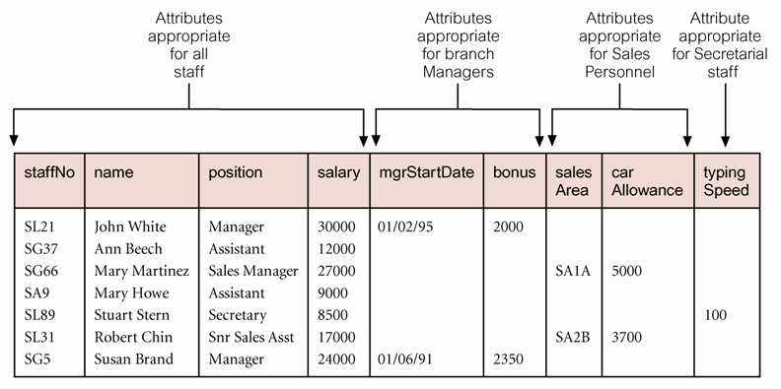
All Staff Relation Holding Details of all Staff

Slide 14
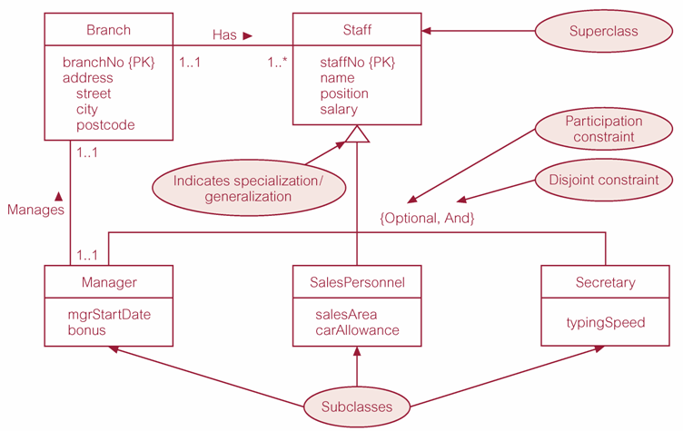
Specialization/Generalization of Staff Entity into Subclasses Representing Job Roles

Slide 15
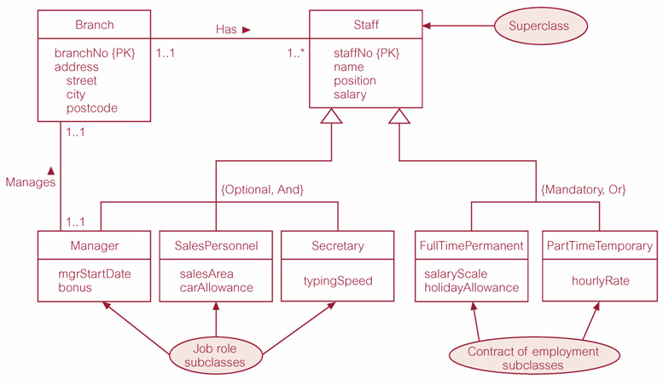
Specialization/Generalization of Staff Entity into Job Roles and Contracts of Employment

Slide 16
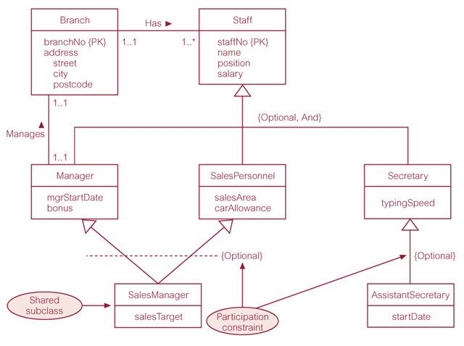
EER Diagram with Shared Subclass and Subclass with its own Subclass

Slide 17
Constraints on Specialization / Generalization
Two constraints that may apply to a specialization/generalization:
participation constraints,
disjoint constraints.
Participation constraint
Determines whether every member in superclass must participate as a member of a subclass.
May be mandatory or optional.

Slide 18
Constraints on Specialization / Generalization
There are four categories of constraints of specialization and generalization:
mandatory and disjoint;
optional and disjoint;
mandatory and non disjoint;
optional and non disjoint.

Slide 19
Constraints on Specialization / Generalization
There are four categories of constraints of specialization and generalization:
mandatory and disjoint;
optional and disjoint;
mandatory and non disjoint;
optional and non disjoint.

Slide 20
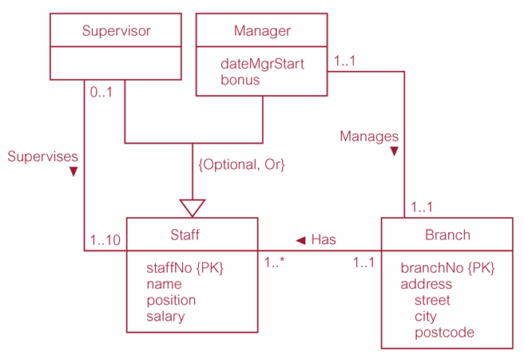
Dream Home Worked Example - Staff Superclass with Supervisor and Manager Subclasses

Slide 21
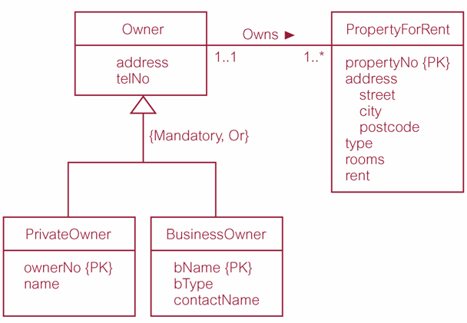
Dream Home Worked Example - Owner Superclass with PrivateOwner and Business Owner Subclasses

Slide 22
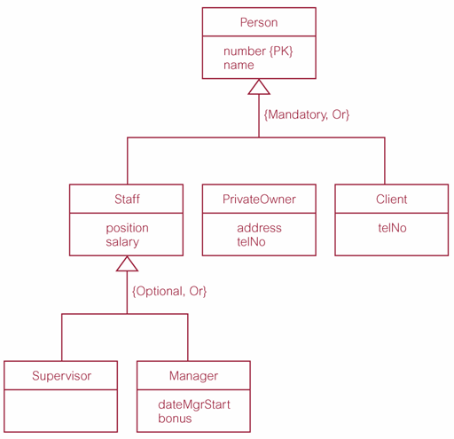
Dream Home Worked Example - Person Superclass with Staff, Private Owner, and Client Subclasses

Slide 23
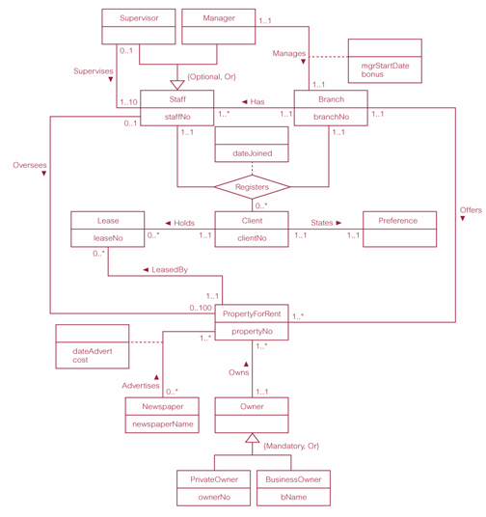
EER Diagram of Branch View of Dream Home with Specialization/Generalization

Slide 24
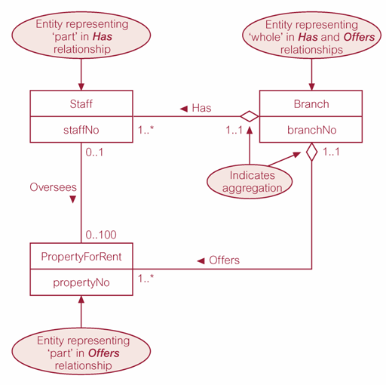
Aggregation
Represents a ‘has-a’ or ‘is-part-of’ relationship between entity types, where one represents the ‘whole’ and the other ‘the part’.

Slide 25
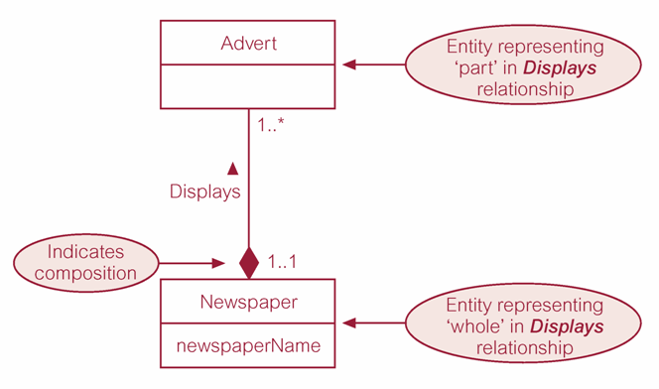
Composition
Specific form of aggregation that represents an association between entities, where there is a strong ownership and coincidental lifetime between the ‘whole’ and the ‘part’.

Slide 26
Thank you

